Slide 1
The NDS Universally Accessible Data Publications Pilot
Jim Myers
Co-chairs: Sharief Youssef, Ray Plante
(Open effort, includes participation from DataOne, DFC, SEAD, and NIST)

Slide 2
Motivation
The NDS/RDA/NSF/Open Data/etc. Vision
The ability to find, access, and reuse data, and to easily annotate and publish new work
To take catalytic steps that support progress towards this vision
If it’s all about the data, let’s start by making sure it, and the information about it, can be accessed!

Slide 3
Use Cases
Domain Discovery Service
Publication Analytics
App/Serivce
App/Serivce
App/Serivce
App/Serivce
App/Serivce
App/Serivce
A researcher drops the identifier for a data publication from an arbitrary source in their analysis tool and the tool is able to retrieve and process a relevant data file(s) automatically or after presenting the researcher with a brows-able display of the publications content so a selection can be made.
The results from a data analysis such as the one just described can be published in a way that they can be retrieved and then analyzed or visualized within another service, duplicating the first use case, without any coordination between the service providers.
A domain-specific catalog is able to discover all data publications in targeted repositories and perform a deep scan of their content to identify and index any relevant content.
New services can analyze the overall corpus of data publications to discover what exists, how it is structured and annotated, what correlates with impact, ….

Slide 4
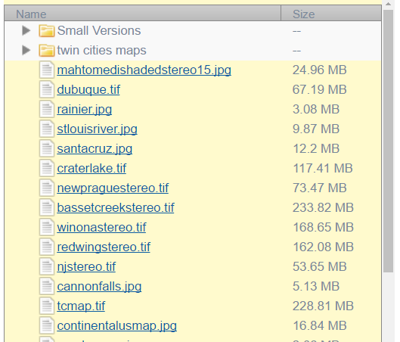
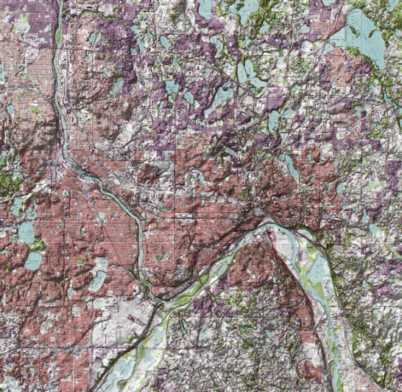
What’s required to enable…
http://doi.org/10.5967/M0NP22DR
Drop a PID
Retrieve and display components and metadata
Retrieve specified file
and process it
“Title”: “njstereo.jpg”
“rdf:Label”: “njstereo.jpg”
“Name”: “njstereo.jpg”

Slide 5
Use Cases
Analysis tools can use a standard library/have one mechanism to access data regardless of publisher
1-1 collaborations/agreements not needed
Catalogs can retrieve any/all metadata
Geospatial, domain, provenance, any other advanced searches can be supported over any sources that can provide the metadata
Researchers can use source-agnostic browsing interfaces that show metadata terms/values and data items
Everyone is pressured to standardize/bridge existing metadata, expand required sets because that is now the primary issue in automating integration…
A data inventory and analysis of holdings across systems becomes possible…

Slide 6
The Challenge
Given an arbitrary data publication identifier today, how much of the process to access it can be automated?
Not much!
Different IDs may or may not be URLs, and have different resolvers
ID schemes may or may not provide some metadata, through schema-specific mechanisms, but they don’t provide all
IDs may only resolve to a human-readable page
The mechanism for retrieving data once finding a landing page is repository/publisher specific
The mechanism for retrieving metadata once finding a landing page is repository/publisher specific
There is no standard syntax for the metadata if/when you find it
All of which is independent of any standards for data format or required metadata fields

Slide 7
UADP Pilot
Task 1: Implement a standard way to get data/metadata given an identifier (API, gateway service, export format, …)
Task 2: Implement a standard harvesting mechanism (that provides, or ties to Task 1 to provide, full data/metadata access)
Task 3: Document the metadata provided by repositories and needed by services
Task 4: Standardize the means to identify and retrieve individual files from within a publication

Slide 8
Timeline
Draft Proposal started after NDS 6 meeting.
Initial wiki materials and refinement of proposal through Nov-Dec 2016.
Kick-off meeting Jan. 13, 2017
Input from pilot participants on current practices and technical approaches
Decision, initial implementations, test data, write-up -

Slide 9
A start on task 1
Sub-group met, discussed, and proposes:

Slide 10
Next steps
If you’re interested, as a source or user of data publications or other interested party, join the pilot!
Discussion tomorrow morning
Mail list
Group wiki
Semi-regular meetings
Access to NDS Labs for dev/testing

Slide 11
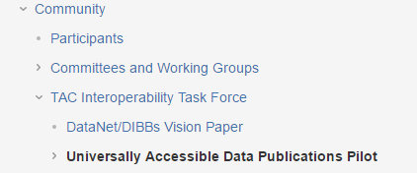
Thanks!
https://nationaldataservice.atlassian.net/wiki/display/NDSC/Universally+Accessible+Data+Publications+Pilot

Slide 12
Title? Abstract? License? Topic? Coordinates? Quality? …
All very important – but when we can’t even retrieve what’s there, being able to interpret it is an academic question
The work in this pilot can be seen as a pre-requisite & catalyst to efforts to standardize vocabularies/required kernels, etc.
It also has value as a stand-alone effort (applications can display metadata to users and retrieve data files they select without further standardization)

Slide 13
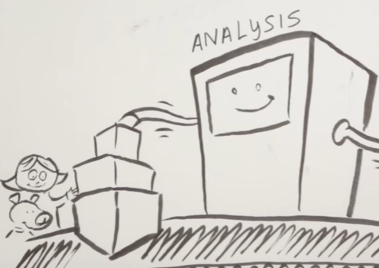
Current examples: For published data, can you find the Data and Metadata …?
DOI
Handle
ARK
RDA PIT
DataCite
EzID
https://dx.doi.org/10.6084/m9.figshare.4515722.v2
https://figshare.com/articles/Data-Driven_Decision-Management_A_Values-focused_Approach_to_Enable_Traceable_Decision_Analytics_for_Adaptive_Climate_Resilience/4515722
https://ndownloader.figshare.com/files/7341470
ESIPandNCSEPosterv1.5.pdf
Or Figshare API (or DataCite: https://api.datacite.org/works/10.6084/m9.figshare.4515722.v2)
doi:10.13012/J8CC0XM
http://dx.doi.org/10.13012/J8CC0XM
http://www.isws.illinois.edu/warm/datatype.asp
http://www.isws.illinois.edu/warm/datalist.asp
http://www.isws.illinois.edu/warm/stationlist.asp?y=2016&m=6&site=&stn=&from=
http://www.isws.illinois.edu/warm/icndata.asp?y=2016&m=6&stn=Freeport
http://www.isws.illinois.edu/warm/data/2016/June/Freeport.txt
Or http://www.isws.illinois.edu/warm/data/cdfs/alldata.zip which contains two zips which contain data files
Which will include Jan 2017 data next month…
Metadata subset at http://ezid.cdlib.org/id/doi:10.13012/J8CC0XMK - html or xml link or https://api.datacite.org/works/10.13012/J8CC0XMK
http://hdl.handle.net/102.100.100/15
https://store.synchrotron.org.au/experiment/view/879/
https://store.synchrotron.org.au/download/experiment/879/tar/ or
login from SFTP button or
Download button that doesn’t have URL, requires selection of dataset parts elsewhere on page
http://doi.org/10.5967/M0NP22DR
https://nced.ncsa.illinois.edu/refrepository/landing.html#tag:sead-data.net,2015:RO_FSrI6AEmuKutlOBEuDif8g
Metadata in ORE-JSON-LD syntax: https://nced.ncsa.illinois.edu/refrepository/api/researchobjects/tag:sead-data.net,2015:RO_FSrI6AEmuKutlOBEuDif8g/meta/oremap.jsonld.txt
Data in BagIT zip file with ORE-JSON-LD metadata: https://nced.ncsa.illinois.edu/refrepository/api/researchobjects/tag:sead-data.net,2015:RO_FSrI6AEmuKutlOBEuDif8g/bag
Notes:
I grabbed a few examples and looked to see whether I could find a way to get the data and/or metadata given the identifier. Without going into details, there are broad variations in whether an API exists, whether one could screen scrape to find metadata and/or download links, and how well one could infer what approach to take.

